Slide 1
JAZZ MUSICIAN AND VENUE REVITALIZATION PROPOSAL
MISSION - GOALS - METHODS
Musician and Venue Development Alliance
June 14, 2021

Slide 2
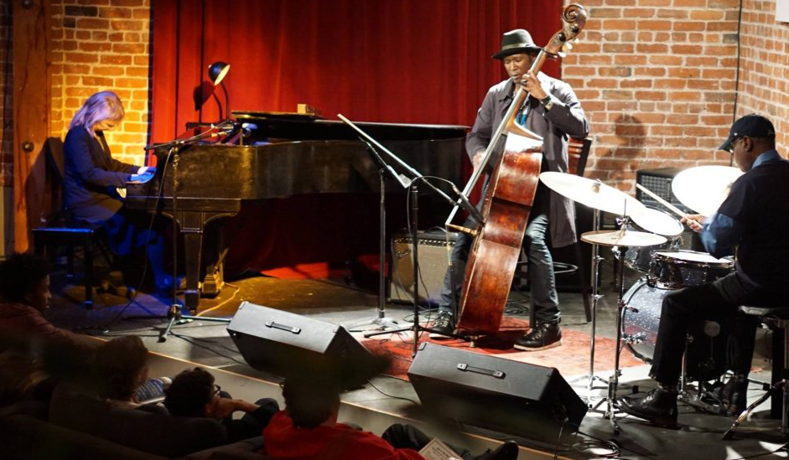
JAZZ IS A LIVING ART FORM
Gaea Schell on piano, Marcus Shelby on bass and Sly Randolph on drums during a recent Guaranteed Fair Wage Fund-sponsored show. (Photo by Kerwin Lee)

Slide 3
SUMMARY
MISSION: Revitalize live jazz in SF by subsidizing small venues, particularly in the southeast neighborhoods, to host performances.
EQUITY: Guarantee fair pay for musicians and meaningful subsidies for small venues, especially in the African American Cultural District.
RECOVERY: The pandemic has greatly impacted live entertainment and cost hundreds if not thousands of jobs. No existing program targets recovery for jazz musicians and the kind of neighborhood venues that are the cultural hubs our community.
THE PLAN: Select up to 30 venues over the course of a 50-week pilot project, starting with a focus on the Bayview. The Program could be administered by JiTN under the fiscal sponsorship of Intersection for The Arts.
RESULT: 6000 gig opportunities for working musicians, 2000 shows at local venues injecting more than $2 Million into the economy for artists, venues, employees and their suppliers.

Slide 4
BACKGROUND
The San Francisco Economic Recovery Task Force in October 2020 recommended new revenue streams be identified to “catalyze neighborhood recovery through the arts.”
Before the pandemic, our city’s “creative sector” was generating $1.45 billion in annual economic activity. The jazz community can play a critical role helping revive this sector, to the benefit of musicians, venues and the community at large.
Jazz was designated by Congress in 1987 as “an American national treasure.” The art form has been recognized globally as a creative cultural synthesis as lived through the African-American experience.
Equity goals are central: Our proposal focuses on “building back better” in neighborhoods such as Bayview, and we are especially focused on steering fair compensation to local musicians and to small local venues.
Tourists and residents alike want a vibrant music scene in San Francisco. But it won’t happen without some assistance.

Slide 5
EQUITY GOALS
Support workforce development for artist musicians through venue support
Define and guarantee fair wages for working professional jazz musicians
Provide subsidies to venues, with an emphasis on small businesses in underserved communities, including BIPOC-owned and operated venues, such as Bayview, the city’s designated African American Arts and Culture District.
Ensure reasonable prices for audience access. (No one turned away for lack of funds)
Guarantee that women, and BIPOC performers are actively recruited,fully employed, represented, and compensated.
Oversee curated lists of musicians created by an artistic advisory board. Jazz in the Neighborhood, Intersection for the Arts and the Independent Musician’s Alliance have long experience in this endeavor.
Choose venues through a diligent review process based on the above stated equity mission standards and goals.

Slide 6
THE NUMBERS
ESTIMATED PROGRAM COSTS*
City Contributes 60%: $540,000
Venues Contribute 40%: $360,000
TOTAL $900,000
*BASED ON 2,000 GIGS @$450 PER ENGAGEMENT, OR $150 PER MUSICIAN BASED ASSUMING ALL GROUPS ARE TRIOS.
OUTCOMES
$900,000 to musicians for 6000 gigs over 50 weeks
$1.25 million support to venues - If 25 customers per show, and each customer spends about $25: $562,500 revenues for venues $287,500 to venue staff (23% of gross) $275,000 to venue suppliers (22% of gross)
At least $2 million in direct payment and new revenues for artists, venues, staff and suppliers as neighborhoods are revitalized across the City.

Slide 7
The Numbers Breakdown
Funding, Revenue Sources
The City $540,000 - contributes $270 (60%) of the cost of a $450 show towards 2000 shows.
The Venues $360,000 - contribute $180 (40%) of the cost of a $450 show towards 2000 shows.
Customers $1.25 million - If each of 25 customers (per show) spends $25 for 2000 shows.
Total 2.15 million generated to pay:
Recipients
Musicians $900,000 for 2000 shows over 50 weeks
Venues $562,500 from customers.
Venue Staff $287,500 from 23% of gross sales.
Suppliers $275,000 from 22% of gross sales.

Slide 8
WHO WE ARE
MUSICIAN AND VENUE DEVELOPMENT ALLIANCE
Musicians, venue owners, community advocates and arts organizations formed MAVDA in 2020, when it became clear that the artistic legacy, cultural roots in the African-American experience, and untapped economic power of live jazz performance in small clubs and other venues could help revitalize some of the San Francisco neighborhoods that need the most help.

Slide 9
MAVDA MEMBERS
Simon Rowe (chair): Australian jazz immigrant to the American Midwest, artist, advocate, architect and founding director of the SF Conservatory of Music’s trailblazing jazz education program. He leads the Simon Rowe Organ Trio, and is a Glen Park resident.
Mario Guarneri: Professional trumpet player and founder of Jazz in the Neighborhood, a nonprofit dedicated to sustaining the art form. JITN has worked to establish equity for local jazz artists, sponsors emerging artists and helps venues offer neighborhood concerts. Since the group’s founding in 2013, JiTN has produced more than 350 concerts across the Bay Area, featuring a roster of more than 500 jazz artists.
Carl Hall: A former reporter for the San Francisco Chronicle and head of the Pacific Media Workers Guild TNG-CWA Local 39521, Hall is co-owner and principal music booker at Word. A Cafe, 5114 Third St., which opened October 2018. He is a longtime resident of Bayview.
Kat Anderson: Co-owner of Word. A Café, Kat is an SF Rec & Park Commissioner, President of the City College Foundation, lawyer, and Local Secretary of Pacific Media Workers Guild.
Eric Whittington: Owner of Bird & Beckett, the Glen Park bookstore and jazz performance space. Eric is co-founder of the Independent Musicians Alliance (IMA) along with Mario Guarneri.
Dwayne Charles: Musician, chef and leader of the Dwayne Charles Project. He is a longtime resident and active neighborhood leader in Bayview.

Slide 10
SUPPORTERS AND ENDORSEMENTS
Supporters and advocates for this proposal include many business owners, leaders and advocates in Bayview and the Greater Bay Area. Here is a partial list:
Angela Wellman- (Musician, Activist, Founder/Oakland Public Conservatory of Music); Barbara Gratta (Gratta Wines), April Spears (African American Arts and Cultural District) and owner of Café Envy and Aunt April’s Chicken and Waffles in Bayview; Al Williams, (Bayview Merchants Association); Patricia and Meaghan Mitchell (Bayview Advocates/Activists).
New York City’s “Musicians for Musicians”(MFM) states:
“MAVDA’s model compensates musicians as professionals and assists small venues in raising local living standards. MFM salutes MAVDA’s achievements and looks forward to similar programs taking place in New York.

